Slide 1
Find your PII reports & make your data safer
by Francisco Gutiérrez González

Slide 2

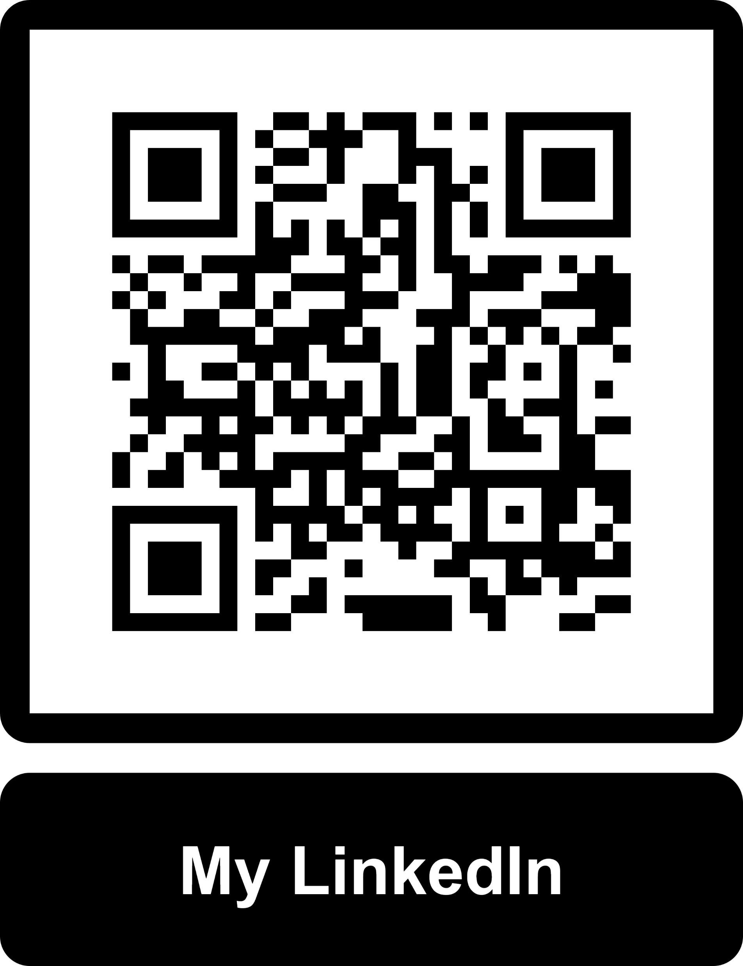
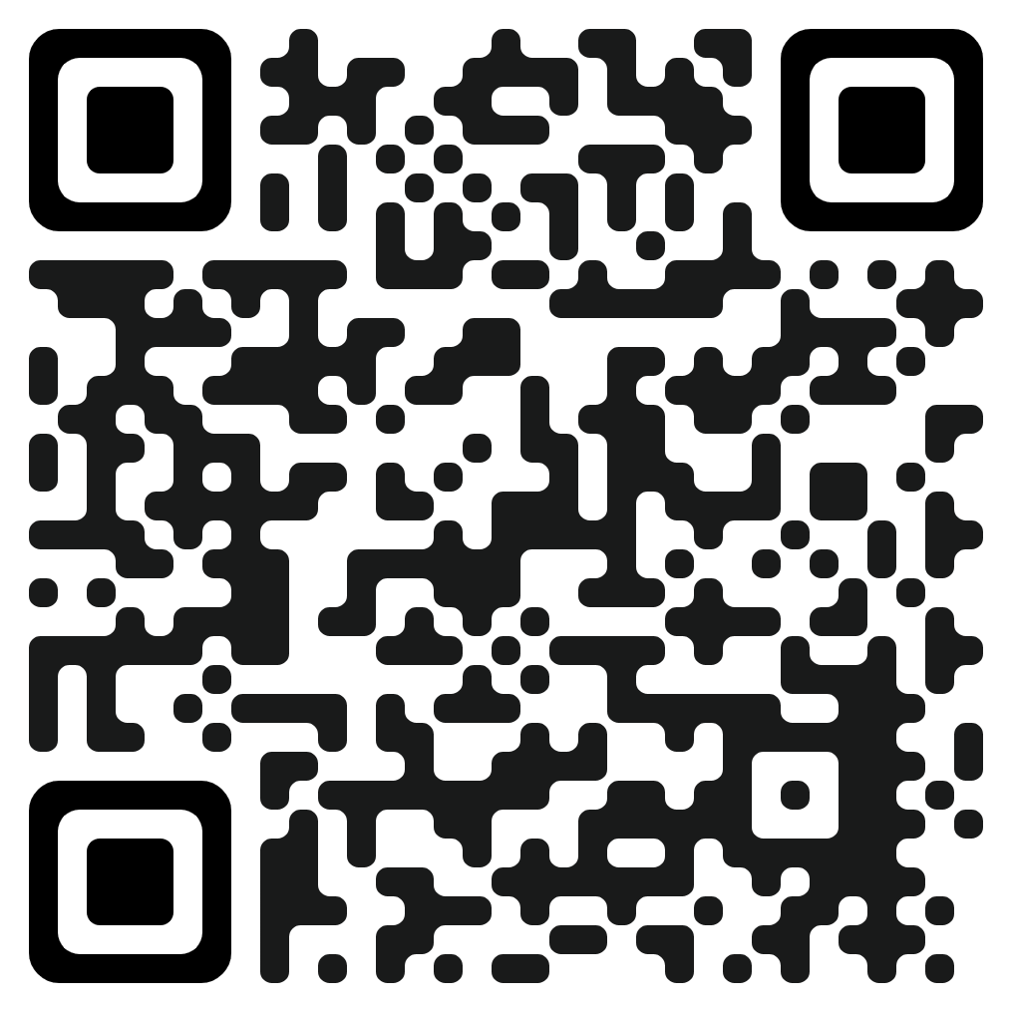
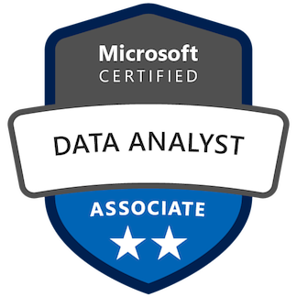

Francisco Gutiérrez González
Power BI Lead @ Entain
Administrator @ Málaga Power BI UG
www.PowerBIStyle.com

Slide 3
Objetives
Where is my PII data?
How is PII data protected?
Who has access to my PII data?
What’s the usage?
Is it being downloaded/exported?
Is someone sending PII data to third parties?

Slide 4
Content
Where is my PII data?
Information Protection & Data Loss Prevention (DLP)
Sensitivity Labels
Policies
Microsoft Defender for cloud applications
Tenant Settings
Monitoring & Audting

Slide 5
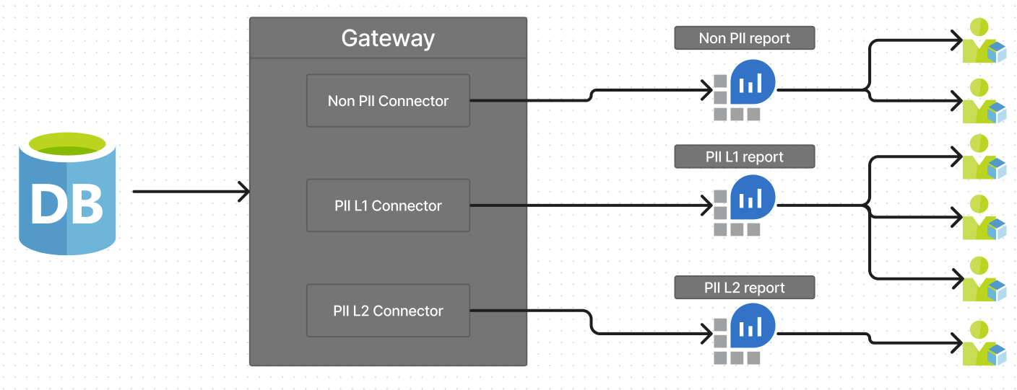
Where is my PII data?
Policies to detect PII data.
Using Synapse & Azure SQL database.
Pushing refreshes through the Gateway.

Slide 6
Information Protection and DLP
Sensitivity Labels
Why to use them?
Tenant Settings:
Allow users to apply sensitivity labels.
Apply sensitivity labels from data sources to their data in Power BI.
Automatically apply sensitivity labels to downstream content.
Workspace admins to override automatically applied sensitivity labels.
Restrict content with protected labels from being shared via link with everyone in your org.

Slide 7
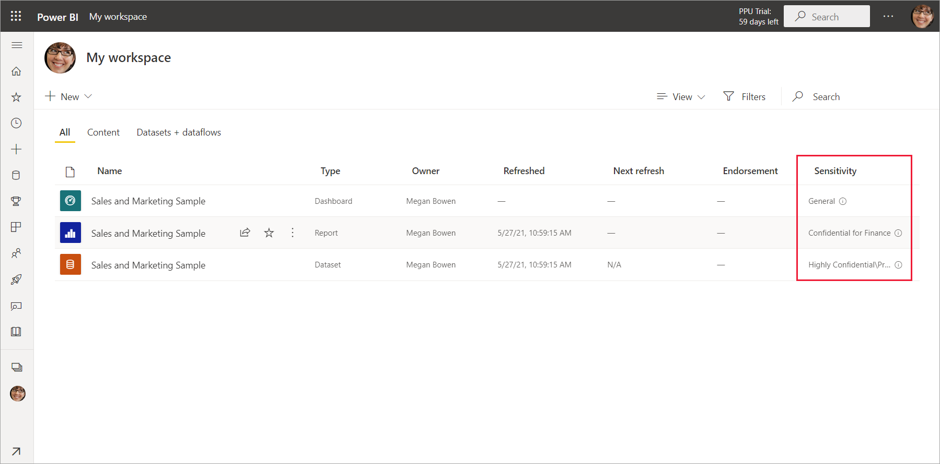
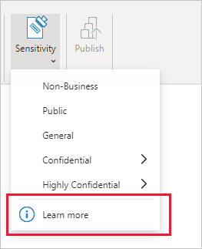
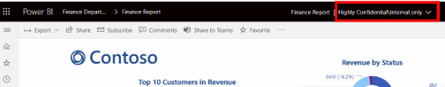
Sensitivity Labels

Slide 8
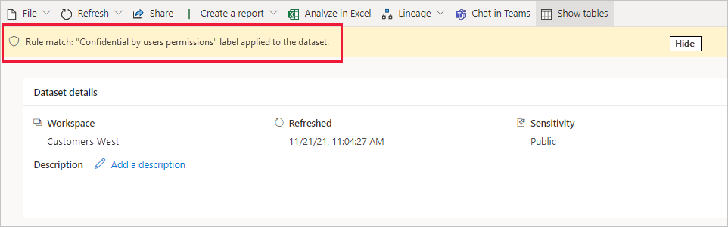
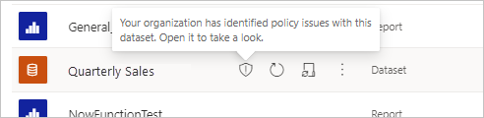
Information Protection and DLP
Policies
Force a label by default
Force to choose a label
Scanning for PII data

Slide 9
Information Protection and DLP
Microsoft Defender for cloud apps
Block downloads from unmanaged devices.
Block downloads of pbix files of sensitive reports.
Alerts:
Massive sensitivity label removal.
Reduction of sensitivity labels (i.e. from High to Public).
Suspicious share.
Mass share of reports.

Slide 10
Tenant Settings
Copy and paste visuals, export to csv, MHTML, XML image.
Publish to Web.
Shareable links to grant access to everyone in your org.
Users to try Power BI paid features.
Guest users:
Invite External users to your organization.
Emails subscriptions to be sent to external users.
Specific users to turn on external data sharing.
Guest users to edit and manage content in the org.
Guest users can work with shared dataset in their own tenant.

Slide 11
Monitoring & Auditing
Access to workspaces, apps, reports and datasets
Usage
Downloads
Change of Tenant Settings
Subscriptions
Personal workspaces
Sensitivity labels
Service principals / service accounts

Slide 12
Reference
https://learn.microsoft.com/en-us/microsoft-365/compliance/create-sensitivity-labels?view=o365-worldwide
https://learn.microsoft.com/en-us/power-bi/enterprise/service-security-sensitivity-label-overview
https://learn.microsoft.com/en-us/power-bi/enterprise/service-security-dlp-policies-for-power-bi
https://learn.microsoft.com/en-us/power-bi/enterprise/service-security-using-defender-for-cloud-apps-controls
https://learn.microsoft.com/en-us/defender-cloud-apps/anomaly-detection-policy#unusual-activities-by-user
https://learn.microsoft.com/en-gb/power-bi/enterprise/service-security-sensitivity-label-audit-schema
https://techcommunity.microsoft.com/t5/security-compliance-and-identity/sensitivity-label-support-in-microsoft-fabric-and-power-bi/ba-p/3874178#:~:text=Power%20BI%20datasets%20that%20connect,when%20brought%20into%20Power%20BI.

Slide 13
Thanks

